Slide 1
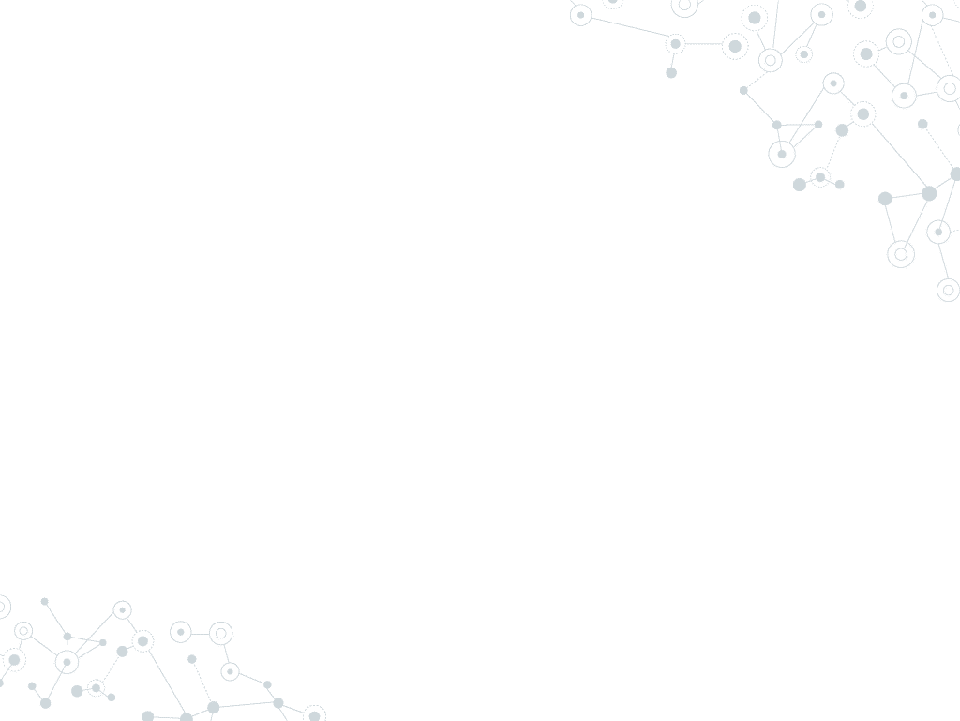
Internet of Things
Lecture 5: IoT Transport and Application Protocols
Mehdi Rasti
Amirkabir University of Technology
Spring 2020

Slide 2
Contents
Introduction and Review of Traditional Transport and Application Protocols
IoT Transport and Application Protocols
IoT Application Transport Methods
Why Not Web Protocol for the Internet of Things?
Request-Response vs. Publish-Subscribe for Data Exchange Models?
IoT Application Protocols: MQTT and CoAP

Slide 3
Contents
Introduction and Review of Traditional Transport and Application Protocols
IoT Transport and Application Protocols
IoT Application Transport Methods
Why Not Web Protocol for the Internet of Things?
Request-Response vs. Publish-Subscribe for Data Exchange Models?
IoT Application Protocols: MQTT and CoAP

Slide 4
Review of Application and Transport Layer Protocols
The transport layer: takes application messages and transmits those message segments into Layer 3, the networking layer
is responsible for end-to-end communication over a network.
It provides logical communication between application processes running on different hosts
The application layer: is responsible for data formatting and presentation
Notes:
This section reviews the selection of a protocol for the transport layer as supported by the TCP/IP architecture in the context of IoT networks. With the TCP/IP protocol, two main protocols are specified for the transport layer:
Transmission Control Protocol (TCP): This connection-oriented protocol requires a session to get established between the source and destination before exchanging data. You can view it as an equivalent to a traditional telephone conversation, in which two phones must be connected and the communication link established before the parties can talk.
User Datagram Protocol (UDP): With this connection-less protocol, data can be quickly sent between source and destination—but with no guarantee of delivery. This is analogous to the traditional mail delivery system, in which a letter is mailed to a destination. Confirmation of the reception of this letter does not happen until another letter is sent in response.
With the predominance of human interactions over the Internet, TCP is the main protocol used at the transport layer. This is largely due to its inherent characteristics, such as its ability to transport large volumes of data into smaller sets of packets. In addition, it ensures reassembly in a correct sequence, flow control and window adjustment, and retransmission of lost packets. These benefits occur with the cost of overhead per packet and per session, potentially impacting overall packet per second performances and latency.
In contrast, UDP is most often used in the context of network services, such as Domain Name System (DNS), Network Time Protocol (NTP), Simple Network Management Protocol (SNMP), and Dynamic Host Control Protocol (DHCP), or for real-time data traffic, including voice and video over IP. In these cases, performance and latency are more important than packet retransmissions because re-sending a lost voice or video packet does not add value. When the reception of packets must be guaranteed error free, the application layer protocol takes care of that function.
While the use of TCP may not strain generic compute platforms and high data-rate networks, it can be challenging and is often overkill on constrained IoT devices and networks. This is particularly true when an IoT device needs to send only a few bytes of data per transaction. When using TCP, each packet needs to add a minimum of 20 bytes of TCP overhead, while UDP adds only 8 bytes. TCP also requires the establishment and potential maintenance of an open logical channel.

Slide 5
Review of Application and Transport Layer Protocols
The Transport Layer:
IP-based networks use either TCP or UDP.
However, the constrained nature of IoT networks requires a closer look at the use of these traditional transport mechanisms.
IoT Application Transport Methods:
The application layer in the Internet is typically based on HTTP.
However, HTTP is not suitable in resource constrained environments because it is fairly verbose in nature and thus incurs a large parsing overhead.
Many alternate protocols have been developed for IoT environments such as CoAP (Constrained Application Protocol) and MQTT (Message Queue Telemetry Transport).
Notes:
This section reviews the selection of a protocol for the transport layer as supported by the TCP/IP architecture in the context of IoT networks. With the TCP/IP protocol, two main protocols are specified for the transport layer:
Transmission Control Protocol (TCP): This connection-oriented protocol requires a session to get established between the source and destination before exchanging data. You can view it as an equivalent to a traditional telephone conversation, in which two phones must be connected and the communication link established before the parties can talk.
User Datagram Protocol (UDP): With this connection-less protocol, data can be quickly sent between source and destination—but with no guarantee of delivery. This is analogous to the traditional mail delivery system, in which a letter is mailed to a destination. Confirmation of the reception of this letter does not happen until another letter is sent in response.
With the predominance of human interactions over the Internet, TCP is the main protocol used at the transport layer. This is largely due to its inherent characteristics, such as its ability to transport large volumes of data into smaller sets of packets. In addition, it ensures reassembly in a correct sequence, flow control and window adjustment, and retransmission of lost packets. These benefits occur with the cost of overhead per packet and per session, potentially impacting overall packet per second performances and latency.
In contrast, UDP is most often used in the context of network services, such as Domain Name System (DNS), Network Time Protocol (NTP), Simple Network Management Protocol (SNMP), and Dynamic Host Control Protocol (DHCP), or for real-time data traffic, including voice and video over IP. In these cases, performance and latency are more important than packet retransmissions because re-sending a lost voice or video packet does not add value. When the reception of packets must be guaranteed error free, the application layer protocol takes care of that function.
While the use of TCP may not strain generic compute platforms and high data-rate networks, it can be challenging and is often overkill on constrained IoT devices and networks. This is particularly true when an IoT device needs to send only a few bytes of data per transaction. When using TCP, each packet needs to add a minimum of 20 bytes of TCP overhead, while UDP adds only 8 bytes. TCP also requires the establishment and potential maintenance of an open logical channel.

Slide 6
Review of Transport Layer Protocols
Transport Layer
Transmission Control Protocol (TCP)
Connection-oriented protocol
It as an equivalent to a traditional telephone conversation, in which two phones must be connected and the communication link established before the parties can talk
User Datagram Protocol (UDP)
Connection-less protocol
This is analogous to the traditional mail delivery system
No guarantee of delivery
* IoT Fundamentals: Networking Technologies, Protocols, and Use Cases for the Internet of Thing, Cisco press, 2017
Notes:
This section reviews the selection of a protocol for the transport layer as supported by the TCP/IP architecture in the context of IoT networks. With the TCP/IP protocol, two main protocols are specified for the transport layer:
Transmission Control Protocol (TCP): This connection-oriented protocol requires a session to get established between the source and destination before exchanging data. You can view it as an equivalent to a traditional telephone conversation, in which two phones must be connected and the communication link established before the parties can talk.
User Datagram Protocol (UDP): With this connection-less protocol, data can be quickly sent between source and destination—but with no guarantee of delivery. This is analogous to the traditional mail delivery system, in which a letter is mailed to a destination. Confirmation of the reception of this letter does not happen until another letter is sent in response.
With the predominance of human interactions over the Internet, TCP is the main protocol used at the transport layer. This is largely due to its inherent characteristics, such as its ability to transport large volumes of data into smaller sets of packets. In addition, it ensures reassembly in a correct sequence, flow control and window adjustment, and retransmission of lost packets. These benefits occur with the cost of overhead per packet and per session, potentially impacting overall packet per second performances and latency.
In contrast, UDP is most often used in the context of network services, such as Domain Name System (DNS), Network Time Protocol (NTP), Simple Network Management Protocol (SNMP), and Dynamic Host Control Protocol (DHCP), or for real-time data traffic, including voice and video over IP. In these cases, performance and latency are more important than packet retransmissions because re-sending a lost voice or video packet does not add value. When the reception of packets must be guaranteed error free, the application layer protocol takes care of that function.
While the use of TCP may not strain generic compute platforms and high data-rate networks, it can be challenging and is often overkill on constrained IoT devices and networks. This is particularly true when an IoT device needs to send only a few bytes of data per transaction. When using TCP, each packet needs to add a minimum of 20 bytes of TCP overhead, while UDP adds only 8 bytes. TCP also requires the establishment and potential maintenance of an open logical channel.

Slide 7
Review of TCP
With the predominance of human interactions over the Internet, TCP is the main protocol used at the transport layer
This is largely due to its inherent characteristics, such as its ability to transport large volumes of data into smaller sets of packets
In addition, it ensures reassembly in a correct sequence, flow control and window adjustment, and retransmission of lost packets
These benefits occur with the cost of overhead per packet and per session, potentially impacting overall packet per second performances and latency.
* IoT Fundamentals: Networking Technologies, Protocols, and Use Cases for the Internet of Thing, Cisco press, 2017

Slide 8
Review of UDP
In contrast, UDP is most often used in the context of network services, such as
Domain Name System (DNS),
Network Time Protocol (NTP),
Simple Network Management Protocol (SNMP), and
Dynamic Host Control Protocol (DHCP), or
for real-time data traffic, including voice and video over IP.
In these cases, performance and latency are more important than packet retransmissions because re-sending a lost voice or video packet does not add value.
When the reception of packets must be guaranteed error free, the application layer protocol takes care of that function.
* IoT Fundamentals: Networking Technologies, Protocols, and Use Cases for the Internet of Thing, Cisco press, 2017

Slide 9
Review of UDP
While the use of TCP may not strain generic compute platforms and high data-rate networks, it can be challenging and is often overkill on constrained IoT devices and networks.
This is particularly true when an IoT device needs to send only a few bytes of data per transaction.
When using TCP, each packet needs to add a minimum of 20 bytes of TCP overhead, while UDP adds only 8 bytes.
TCP also requires the establishment and potential maintenance of an open logical channel
* IoT Fundamentals: Networking Technologies, Protocols, and Use Cases for the Internet of Thing, Cisco press, 2017

Slide 10
Review of HTPP
HTTP is a protocol which allows the fetching of resources, such as HTML documents.
It is the foundation of any data exchange on the Web and it is a client-server protocol, which means requests are initiated by the recipient, usually the Web browser.
A complete document is reconstructed from the different sub-documents fetched, for instance text, layout description, images, videos, scripts, and more.
An overview of HTTP, Online Available, https://developer.mozilla.org/en-US/docs/Web/HTTP/Overview

Slide 11
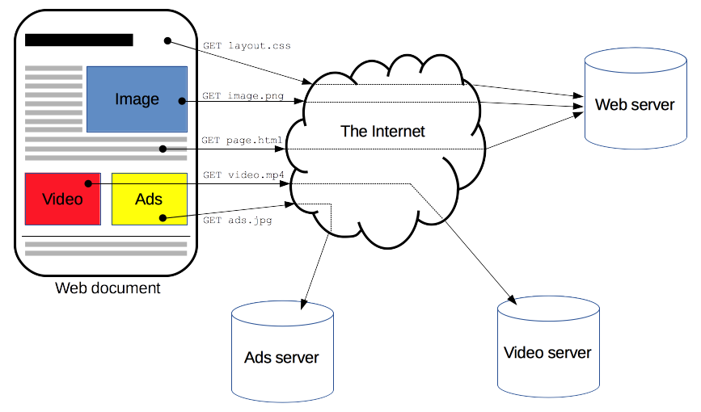
Review of HTPP
An overview of HTTP, Online Available, https://developer.mozilla.org/en-US/docs/Web/HTTP/Overview

Slide 12
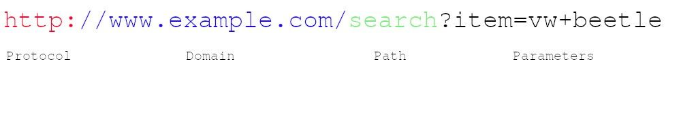
Review of HTPP
URLs
The URL (Uniform Resource Locator) is probably the most known concept of the Web.
A URL is a web address used to identify resources on the Web.
The idea of the web is structured around resources.
From its beginnings the Web was the platform for sharing text/HTML files, documents, images etc, and as such it can be considered a collection of resources.
An introduction to HTTP: everything you need to know, Online Available, https://www.freecodecamp.org/news/http-and-everything-you-need-to-know-about-it/

Slide 13
Review of HTPP
Domain — Name that is used to identify one or more IP addresses where the resource is located.
Path —Specifies the resource location on the server. It uses the same logic as a resource location used on the device where you are reading this article (i.e. /search/cars/VWBeetle.pdf or C:/my cars/VWBeetle.pdf).
Parameters — Additional data used to identify or filter the resource on the server.
An introduction to HTTP: everything you need to know, Online Available, https://www.freecodecamp.org/news/http-and-everything-you-need-to-know-about-it/

Slide 14
Review of HTPP
HTTP Requests
In HTTP, every request must have an URL address.
Additionally, the request needs a method.
The four main HTTP methods are:
GET
PUT
POST
DELETE
An introduction to HTTP: everything you need to know, Online Available, https://www.freecodecamp.org/news/http-and-everything-you-need-to-know-about-it/

Slide 15
Review of HTPP
HTTP flow
When a client wants to communicate with a server, either the final server or an intermediate proxy, it performs the following steps:
Open a TCP connection:
The TCP connection is used to send a request, or several, and receive an answer.
The client may open a new connection, reuse an existing connection, or open several TCP connections to the servers.
Send an HTTP message:
An overview of HTTP, Online Available, https://developer.mozilla.org/en-US/docs/Web/HTTP/Overview

Slide 16
Review of HTPP
HTTP functions as a request–response protocol in the client–server computing model.
A web browser, for example, may be the client and an application running on a computer hosting a website may be the server.
The client submits an HTTP request message to the server.
The server, which provides resources such as HTML files and other content, or performs other functions on behalf of the client, returns a response message to the client.
An overview of HTTP, Online Available, https://developer.mozilla.org/en-US/docs/Web/HTTP/Overview

Slide 17
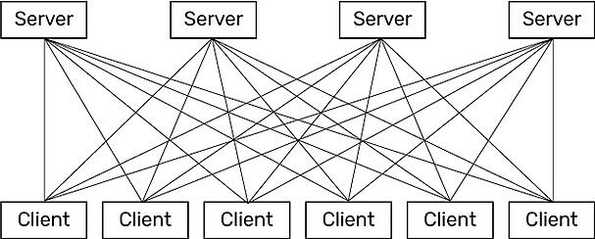
Review of HTPP
* IoT Fundamentals: Networking Technologies, Protocols, and Use Cases for the Internet of Thing, Cisco press, 2017

Slide 18
Review of HTTP
HTTP is based on TCP, the data stream-based transmission method in the TCP/IP stack.
Among other things, TCP requires that data packets are equipped with counters in order to be able to correct the order of incoming packets in case of doubt.
TCP devices need buffers to store and manage packets between them.
Many small devices therefore use UDP, which delivers datagrams individually and does not guarantee delivery or the actual order.
This makes the implementation leaner and more resource-efficient.
Unfortunately, HTTP does not pay attention to UDP, newer protocols like QUIC rely on UDP, but are not yet so widespread.
Application protocols for the Internet of Things, online available, https://www.wespeakiot.com/application-protocols-for-the-internet-of-things/

Slide 19
Contents
Introduction and Review of Traditional Transport and Application Protocols
IoT Transport and Application Protocols
IoT Application Transport Methods
Why Not Web Protocol for the Internet of Things?
Request-Response vs. Publish-Subscribe for Data Exchange Models?
IoT Application Protocols: MQTT and CoAP

Slide 20
IoT Application Transport Methods
As an example, consider the Device Language Message Specification/Companion Specification for Energy Metering (DLMS/COSEM) application layer protocol
a popular protocol for reading smart meters in the utilities space, is the de facto standard in Europe.
Adjustments or optimizations to this protocol should be made depending on the IoT transport protocols that are present in the lower layers.
For example, if you compare the transport of DLMS/COSEM over a cellular network versus an LLN deployment, you should consider the following:
Select TCP for cellular networks because these networks are typically more robust and can handle the overhead.
For LLNs, where both the devices and network itself are usually constrained, UDP is a better choice and often mandatory.

Slide 21
IoT Application Transport Methods
DLMS/COSEM can reduce the overhead associated with session establishment by offering a “long association” over LLNs.
Long association means that sessions stay up once in place because the communications overhead necessary to keep a session established is much less than is involved in opening and closing many separate sessions over the same time period.
Conversely, for cellular networks, a short association better controls the costs by tearing down the open associations after transmitting.
When transferring large amounts of DLMS/COSEM data, cellular links are preferred to optimize each open association.
Smaller amounts of data can be handled efficiently over LLNs.
Because packet loss ratios are generally higher on LLNs than on cellular networks, keeping the data transmission amounts small over LLNs limits the retransmission of large numbers of bytes.

Slide 22
IoT Application Transport Methods
The following categories of IoT application protocols and their transport methods are explored in the following sections:
Application layer protocol not present:
In this case, the data payload is directly transported on top of the lower layers.
No application layer protocol is used.
Generic web-based protocols:
Generic protocols, are found on many consumer- and enterprise-class IoT devices that communicate over non-constrained networks.
A web protocol like HTTP can also be used on small devices.
In the Arduino boards area, for example, there are many examples of smart sensors that have their own web server.
The user can direct his browser to the IP address of the device and receive data directly in the form of a web page
IoT application layer protocols:
IoT application layer protocols are devised to run on constrained nodes with a small compute footprint and are well adapted to the network bandwidth constraints on cellular or satellite links or constrained 6LoWPAN networks.
Message Queuing Telemetry Transport (MQTT) and Constrained Application Protocol (CoAP), covered later in this chapter, are two well-known examples of IoT application layer protocols.

Slide 23
Application Layer Protocol Not Present
As introduced before, IETF RFC 7228 devices defined as class 0 send or receive only a few bytes of data
For myriad reasons, such as processing capability, power constraints, and cost, these devices do not implement a fully structured network protocol stack, such as IP, TCP, or UDP, or even an application layer protocol.
Class 0 devices are usually simple smart objects that are severely constrained.
Implementing a robust protocol stack is usually not useful and sometimes not even possible with the limited available resources.
* IoT Fundamentals: Networking Technologies, Protocols, and Use Cases for the Internet of Thing, Cisco press, 2017

Slide 24
Application Layer Protocol Not Present
For example, consider low-cost temperature and relative humidity (RH) sensors sending data over an LPWA LoRaWAN infrastructure.
Temperature is represented as 2 bytes and RH as another 2 bytes of data. Therefore, this small data payload is directly transported on top of the LoRaWAN MAC layer, without the use of TCP/IP.
* IoT Fundamentals: Networking Technologies, Protocols, and Use Cases for the Internet of Thing, Cisco press, 2017

Slide 25
Application Layer Protocol Not Present
Following Example shows the raw data for temperature and relative humidity and how it can be decoded by the application.
* IoT Fundamentals: Networking Technologies, Protocols, and Use Cases for the Internet of Thing, Cisco press, 2017

Slide 26
Application Layer Protocol Not Present
While many constrained devices, such as sensors and actuators, have adopted deployments that have no application layer, this transportation method has not been standardized.
This lack of standardization makes it difficult for generic implementations of this transport method to be successful from an interoperability perspective.
* IoT Fundamentals: Networking Technologies, Protocols, and Use Cases for the Internet of Thing, Cisco press, 2017

Slide 27
Application Layer Protocol Not Present
Consider different kinds of temperature sensors from different manufacturers.
These sensors will report temperature data in varying formats.
A temperature value will always be present in the data transmitted by each sensor, but decoding this data will be vendor specific.
If you scale this scenario out across hundreds or thousands of sensors, the problem of allowing various applications to receive and interpret temperature values delivered in different formats becomes increasingly complex.
The solution to this problem is to use an IoT data broker, as detailed in Figure of next slide
An IoT data broker is a piece of middleware that standardizes sensor output into a common format that can then be retrieved by authorized applications.

Slide 28
Application Layer Protocol Not Present
IoT Data Broker
* IoT Fundamentals: Networking Technologies, Protocols, and Use Cases for the Internet of Thing, Cisco press, 2017

Slide 29
Application Layer Protocol Not Present
You should note that IoT data brokers are also utilized from a commercial perspective to distribute and sell IoT data to third parties.
Companies can provide access to their data broker from another company’s application for a fee.
This makes an IoT data broker a possible revenue stream, depending on the value of the data it contains.
* IoT Fundamentals: Networking Technologies, Protocols, and Use Cases for the Internet of Thing, Cisco press, 2017

Slide 30
Application Layer Protocol Not Present
Directly transporting data payload without a structured network stack clearly optimizes data transmission over low-data-rate networks,
However, the lack of a data model implies that each application needs to know how to interpret the data-specific format.
This becomes increasingly complex for larger networks of devices with different data payload formats.
Furthermore, it makes the IoT application environment challenging in terms of evolution, development, interoperability, and so on, and often calls for structured data models and data broker applications.
* IoT Fundamentals: Networking Technologies, Protocols, and Use Cases for the Internet of Thing, Cisco press, 2017

Slide 31
Web Protocol for the Internet of Things
A web protocol like HTTP can also be used on small devices.
In the Arduino boards area, for example, there are many examples of smart sensors that have their own web server.
The user can direct his browser to the IP address of the device and receive data directly in the form of a web page.
Why don’t all small devices automatically become “web services”?
Application protocols for the Internet of Things, online available, https://www.wespeakiot.com/application-protocols-for-the-internet-of-things/

Slide 32
Web Protocol for the Internet of Things
Let’s take a closer look at the way HTTP works
The protocol is used to interact with web resources (e. g. web pages or forms) on a server.
Several methods are available for this purpose.
Most inquiries are made to request data (“GET”),
Other inquiries data can be transferred, e. g. when an order form has to be filled out in the online shop (method “POST”).
In principle, HTTP methods can also be used for interaction with devices:
Getting data from the device (“GET /temperature”), or
Control things/actuators (“POST /fan/control”).
Most developers are already familiar with HTTP web services. So, why not just have IoT devices connect to web services?
Application protocols for the Internet of Things, online available, https://www.wespeakiot.com/application-protocols-for-the-internet-of-things/

Slide 33
HTTP: Not necessarily suitable for small devices
There are several reasons why HTTP is not well suited to interacting with constrained devices:
HTTP is a heavy weight protocol with many headers and rules
HTTP is a chatty protocol from the point of view of resource restriction.
For example, meta information such as the accepted formats or the desired language are transmitted to the server in plain text form.
The header of an HTTP request can already be large, and the header of an HTTP response can easily contain several hundred bytes.
For the query of a web page with several megabytes of size this is not bad, but for the query of a temperature value in the range of approx. 5 bytes it is significant whether the transmission protocol is slim or rather broad.
Application protocols for the Internet of Things, online available, https://www.wespeakiot.com/application-protocols-for-the-internet-of-things/

Slide 34
HTTP: Not Necessarily Suitable for Small Devices
HTTP is a synchronous protocol.
The client waits for the server to respond.
That is a requirement for web browsers, but it comes at the cost of poor scalability.
In the world of IoT, the large number of devices and most likely an unreliable / high latency network have made synchronous communication problematic.
An asynchronous messaging protocol is much more suitable for IoT applications. The sensors can send in readings, and let the network figure out the optimal path and timing for delivery to its destination devices and services.
Getting to know MQTT, online available, https://developer.ibm.com/articles/iot-mqtt-why-good-for-iot/

Slide 35
HTTP: Not Necessarily Suitable for Small Devices
HTTP is one-way.
The client must initiate the connection.
In an IoT application, the devices or sensors are typically clients, which means that they cannot passively receive commands from the network.
HTTP is a 1-1 protocol.
The client makes a request, and the server responds.
It is difficult and expensive to broadcast a message to all devices on the network, which is a common use case in IoT applications.
Getting to know MQTT, online available, https://developer.ibm.com/articles/iot-mqtt-why-good-for-iot/

Slide 36
IoT Protocol Stack- Application Layer Protocols
When considering constrained networks and/or a large-scale deployment of constrained nodes, verbose web-based and data model protocols, as discussed in the previous section, may be too heavy for IoT applications.
To address this problem, the IoT industry is working on new lightweight protocols that are better suited to large numbers of constrained nodes and networks.
Two of the most popular protocols are CoAP and MQTT.
Before introducing CoAP and MQTT, we review two data exchange models
* IoT Fundamentals: Networking Technologies, Protocols, and Use Cases for the Internet of Thing, Cisco press, 2017

Slide 37
Request-Response vs. Publish-Subscribe
How does a spreadsheet get to the printer, a YouTube video get to your smartphone, or—most important for automation engineers—a value from a sensor get to your HMI?
Two Communication (Data Exchange) Models:
Request and Response
Publish and Subscribe
Request-response vs. publish-subscribe, part 1: What's the diff? , online available, https://blog.opto22.com/optoblog/request-response-vs-pub-sub-part-1
Notes:
We all know that computers and other electronic devices—printers, routers, laptops, smartphones, and more—are networked so they can exchange information.
But how does that information get where it’s supposed to go?
How does a spreadsheet get to the printer, a YouTube video get to your smartphone, or—most important for automation engineers—a value from a sensor get to your HMI?
Let's take a look at a couple of models for network communication, and then in part 2 we'll compare them to see which one might be better in certain scenarios. The two we'll look at are request-response and publish-subscribe.

Slide 38
Request-Response vs. Publish-Subscribe
Request and Response Model
A client computer or software requests data or services, and a server computer or software responds to the request by providing the data or service
Examples:
Send a spreadsheet to the network printer
your spreadsheet program is the client and print server, responds to the request and allocates resources for printers on the network.
Watching the YouTube video on your smartphone
your web browser or YouTube app is the client, YouTube’s web server receives the request and responds by serving the video page to you
Request-response vs. publish-subscribe, part 1: What's the diff? , online available, https://blog.opto22.com/optoblog/request-response-vs-pub-sub-part-1
Notes:
For example, when you send a spreadsheet to the printer, your spreadsheet program is the client. Its request for printer services goes to your company’s print server, which responds to the request and allocates resources for printers on the network. The print server handles all the client requests for printing, making sure your spreadsheet and your coworkers’ print jobs are all completed in an orderly way.
When you want to watch that YouTube video on your smartphone, your web browser or YouTube app is the client, requesting the video over that giant of networks, the Internet. YouTube’s web server receives the request and responds by serving the video page to you, along with the other millions of video pages going to other millions of viewers worldwide.
In automation, the client is typically a PC, and the server is a PLC or PAC. The HMI application on your PC requests data from the PLC or PAC in order to display it on the monitor.
You can imagine request-response as a client sending an empty truck out to be filled with data. The server responds by putting the data on the truck and sending it back.

Slide 39
Request-Response vs. Publish-Subscribe
Publish and Subscribe
A central source called a broker (also sometimes called a server) which receives and distributes all data.
Pub-sub clients can publish data to the broker or subscribe to get data from it—or both.
Clients that publish data send it only when the data changes (report by exception, or RBE).
Clients that subscribe to data automatically receive it from the broker/server, but again, only when it changes.
The broker does not store data; it simply moves it from publishers to subscribers.
When data comes in from a publisher, the broker promptly sends it off to any client subscribed to that data.
Request-response vs. publish-subscribe, part 1: What's the diff? , online available, https://blog.opto22.com/optoblog/request-response-vs-pub-sub-part-1

Slide 40
Request-Response vs. Publish-Subscribe-Which to Use?
In a request-response architecture, each client opens a direct connection to each server, because the client requests data directly from the server.
In automation, as fast as multiple times per second—and servers repetitively respond:
Q: What’s the sensor value? A: 10 Q: What’s the sensor value? A: 10 Q: What’s the sensor value? A: 10 Q: What’s the sensor value? A: 10 Q: What’s the sensor value? A: 10 Q: What’s the sensor value? A: 9 Q: What’s the sensor value? A: 9
If your network is robust and has few servers, request-response model works very well.
As long as the server has the capacity to respond to client demands and the network can handle the volume of traffic, request-response is a proven, reliable communication method. It's particularly useful for communications over a secure internal network.
Request-response vs. publish-subscribe, part 2: Which to use?, online available, https://blog.opto22.com/optoblog/request-response-vs-pub-sub-part-2

Slide 41
Request-Response vs. Publish-Subscribe-Which to Use?
What about traffic volume?
If you have multiple servers with multiple clients, however, the volume of traffic in a request-response model can quickly become a problem.
Request-response vs. publish-subscribe, part 2: Which to use?, online available, https://blog.opto22.com/optoblog/request-response-vs-pub-sub-part-2

Slide 42
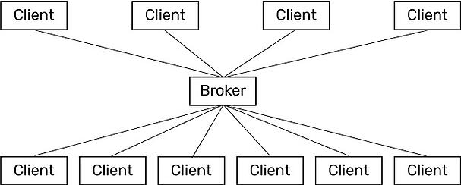
Request-Response vs. Publish-Subscribe-Which to Use?
In contrast, a pub-sub architecture simplifies communications.
Direct connections and repetitive requests for data are not needed.
The web of links is replaced by a single link from each device to the broker (also called a server).
The connection between client and broker is kept open and is incredibly lightweight.
Only two things travel over this connection: changed data, and a tiny heartbeat to let the broker know that the client is still there.
Pub-sub: good for heavy traffic and lightweight networks
Request-response vs. publish-subscribe, part 2: Which to use?, online available, https://blog.opto22.com/optoblog/request-response-vs-pub-sub-part-2

Slide 43
Request-Response vs. Publish-Subscribe-Which to Use?
So a pub-sub model can make sense if you have many servers and many clients that need to share data and services.
Since the broker is the central clearinghouse for data, individual servers don’t have to strain to serve multiple clients, and clients don’t have to connect to multiple servers.
In addition, network traffic is reduced overall, because data is published and sent on a report-by-exception (RBE) basis.
that is, only when the data changes—rather than at regular intervals.
Pub-sub can also make sense when it's difficult to set up a direct connection between a client and a server, or when the network is low-bandwidth, expensive, or unreliable—for example, when monitoring equipment in remote locations.
Request-response vs. publish-subscribe, part 2: Which to use?, online available, https://blog.opto22.com/optoblog/request-response-vs-pub-sub-part-2

Slide 44
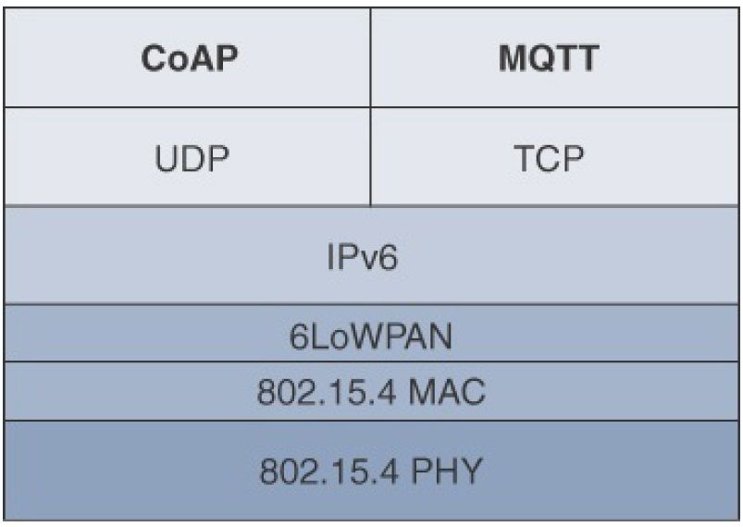
IoT Application Layer Protocols
Constrained Application Protocol (CoAP)
Uses both client-server and pub-Sub methods
UDP-based
Message Queuing Telemetry Transport (MQTT)
Based on pub-sub
TCP-based

Slide 45
IoT Application Layer Protocols-CoAP
CoAP has been created close to HTTP in several aspects:
It is basically a request/response protocol,
It integrates the URIs known from the web world to name resources.
It also adopts some of the query methods (such as “GET”,”PUT”,”POST”, etc.) and defines response codes similar to those of HTTP (e. g. 4.04 “Not found” if a resource could not be found).
Web developers who have grown up with HTTP can quickly find their way around CoAP.
Application protocols for the Internet of Things, online available, https://www.wespeakiot.com/application-protocols-for-the-internet-of-things/

Slide 46
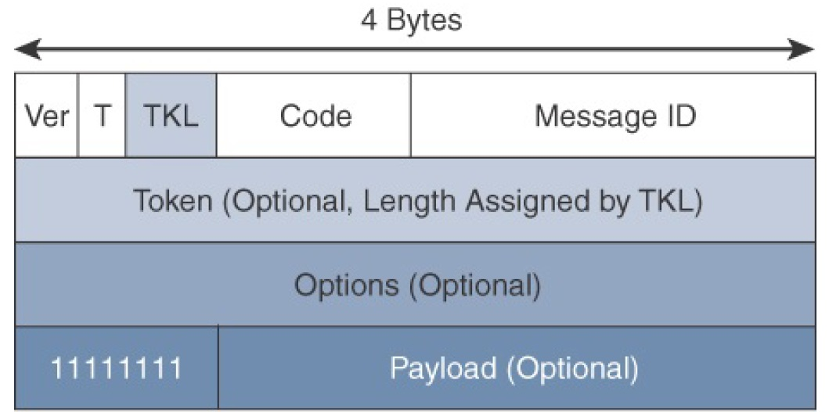
IoT Protocol Stack- Application Layer Protocols
Application Layer Protocols- CoAP
The CoAP framework defines simple and flexible ways to manipulate sensors and actuators for data or device management
A CoAP message is composed of
a short fixed length Header field (4 bytes),
a variable-length but mandatory Token field
(0–8 bytes),
Options fields if necessary, and the Payload field
* IoT Fundamentals: Networking Technologies, Protocols, and Use Cases for the Internet of Thing, Cisco press, 2017
Notes:
CoAP can run over IPv4 or IPv6. However, it is recommended that the message fit within a single IP packet and UDP payload to avoid fragmentation. For IPv6, with the default MTU size being 1280 bytes and allowing for no fragmentation across nodes, the maximum CoAP message size could be up to 1152 bytes, including 1024 bytes for the payload. In the case of IPv4, as IP fragmentation may exist across the network, implementations should limit themselves to more conservative values and set the IPv4 Don’t Fragment (DF) bit.
While most sensor and actuator traffic utilizes small-packet payloads, some use cases, such as firmware upgrades, require the capability to send larger payloads. CoAP doesn’t rely on IP fragmentation but defines (in RFC 7959) a pair of Block options for transferring multiple blocks of information from a resource representation in multiple request/response pairs.

Slide 47
CoAP Message Fields
* IoT Fundamentals: Networking Technologies, Protocols, and Use Cases for the Internet of Thing, Cisco press, 2017
Notes:
CoAP can run over IPv4 or IPv6. However, it is recommended that the message fit within a single IP packet and UDP payload to avoid fragmentation. For IPv6, with the default MTU size being 1280 bytes and allowing for no fragmentation across nodes, the maximum CoAP message size could be up to 1152 bytes, including 1024 bytes for the payload. In the case of IPv4, as IP fragmentation may exist across the network, implementations should limit themselves to more conservative values and set the IPv4 Don’t Fragment (DF) bit.
While most sensor and actuator traffic utilizes small-packet payloads, some use cases, such as firmware upgrades, require the capability to send larger payloads. CoAP doesn’t rely on IP fragmentation but defines (in RFC 7959) a pair of Block options for transferring multiple blocks of information from a resource representation in multiple request/response pairs.

Slide 48
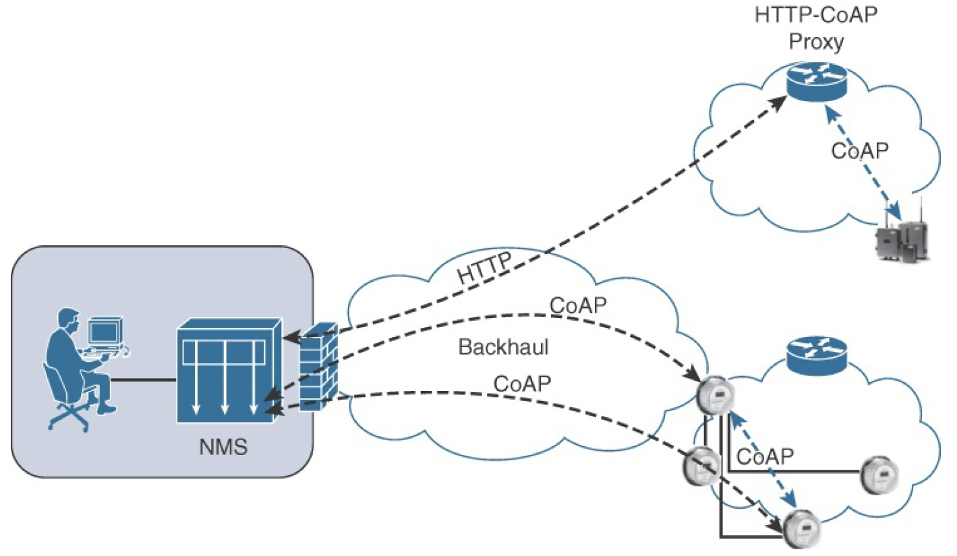
IoT Application Layer Protocols-CoAP
Application Layer Protocols- CoAP
CoAP Communications in IoT Infrastructures
Connections can be between devices located on the same or different constrained networks or between devices and generic Internet or cloud servers, all operating over IP.
* IoT Fundamentals: Networking Technologies, Protocols, and Use Cases for the Internet of Thing, Cisco press, 2017
Notes:
Connections can be between devices located on the same or different constrained networks or between devices and generic Internet or cloud servers, all operating over IP. Proxy mechanisms are also defined, and RFC 7252 details a basic HTTP mapping for CoAP. As both HTTP and CoAP are IP-based protocols, the proxy function can be located practically anywhere in the network, not necessarily at the border between constrained and non-constrained networks.
Just like HTTP, CoAP is based on the REST architecture, but with a “thing” acting as both the client and the server. Through the exchange of asynchronous messages, a client requests an action via a method code on a server resource. A uniform resource identifier (URI) localized on the server identifies this resource. The server responds with a response code that may include a resource representation. The CoAP request/response semantics include the methods GET, POST, PUT, and DELETE.

Slide 49
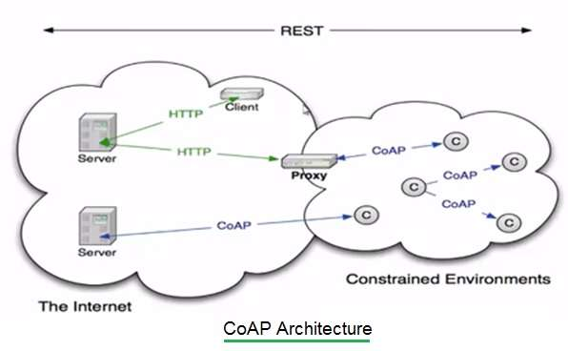
IoT Application Layer Protocols-CoAP
Application Layer Protocols- CoAP
CoAP Architecture
* https://www.rfwireless-world.com/Terminology/Difference-between-CoAP-and-HTTP.html

Slide 50
IoT Application Layer Protocols-CoAP
Through the exchange of asynchronous messages, a client requests an action via a method code on a server resource.
A uniform resource identifier (URI) localized on the server identifies this resource.
The server responds with a response code that may include a resource representation.
The CoAP request/response semantics include the methods GET, POST, PUT, and DELETE.
* IoT Fundamentals: Networking Technologies, Protocols, and Use Cases for the Internet of Thing, Cisco press, 2017
Notes:
CoAP defines four types of messages: confirmable, non-confirmable, acknowledgement, and reset. Method codes and response codes included in some of these messages make them carry requests or responses. CoAP code, method and response codes, option numbers, and content format have been assigned by IANA as Constrained RESTful Environments (CoRE) parameters.
A message that does not require reliable transmission (for example, each single measurement out of a stream of sensor data) can be sent as a Non-confirmable message (NON). These are not acknowledged, but still have a Message ID for duplicate detection (in this example, 0x01a0); see Figure 3. When a recipient is not able to process a Non-confirmable message, it may reply with a Reset message (RST).

Slide 51
IoT Application Layer Protocols-CoAP
CoAP Messages Type
Confirmable
a reliable transmission of messages on UDP protocol
basic congestion control with a default time-out
simple stop and wait retransmission with exponential back-off mechanism
detection of duplicate messages through a message ID
while running over UDP, CoAP offers a reliable transmission of messages when a CoAP header is marked as “confirmable.”
Non-Confirmable
not require reliable transmission
* IoT Fundamentals: Networking Technologies, Protocols, and Use Cases for the Internet of Thing, Cisco press, 2017
Notes:
CoAP defines four types of messages: confirmable, non-confirmable, acknowledgement, and reset. Method codes and response codes included in some of these messages make them carry requests or responses. CoAP code, method and response codes, option numbers, and content format have been assigned by IANA as Constrained RESTful Environments (CoRE) parameters.
A message that does not require reliable transmission (for example, each single measurement out of a stream of sensor data) can be sent as a Non-confirmable message (NON). These are not acknowledged, but still have a Message ID for duplicate detection (in this example, 0x01a0); see Figure 3. When a recipient is not able to process a Non-confirmable message, it may reply with a Reset message (RST).

Slide 52
IoT Application Layer Protocols-CoAP
CoAP Messages Type
Acknowledgement
the recipient must explicitly either acknowledge or reject the confirmable message using the same message ID
Reset
a recipient sends a reset message when can’t process a confirmable or non-confirmable message
* IoT Fundamentals: Networking Technologies, Protocols, and Use Cases for the Internet of Thing, Cisco press, 2017
Notes:
CoAP defines four types of messages: confirmable, non-confirmable, acknowledgement, and reset. Method codes and response codes included in some of these messages make them carry requests or responses. CoAP code, method and response codes, option numbers, and content format have been assigned by IANA as Constrained RESTful Environments (CoRE) parameters.
A message that does not require reliable transmission (for example, each single measurement out of a stream of sensor data) can be sent as a Non-confirmable message (NON). These are not acknowledged, but still have a Message ID for duplicate detection (in this example, 0x01a0); see Figure 3. When a recipient is not able to process a Non-confirmable message, it may reply with a Reset message (RST).

Slide 53
IoT Application Layer Protocols-CoAP
CoAP Messages semantics
Get
Post
Put
Delete
Method codes and response codes included in some of these four-types messages make them carry requests or responses
* IoT Fundamentals: Networking Technologies, Protocols, and Use Cases for the Internet of Thing, Cisco press, 2017
Notes:
From RFC-7252
GET
The GET method retrieves a representation for the information that currently corresponds to the resource identified by the request URI. If the request includes an Accept Option, that indicates the preferred content-format of a response. If the request includes an ETag Option, the GET method requests that ETag be validated and that the representation be transferred only if validation failed. Upon success, a 2.05 (Content) or 2.03 (Valid) Response Code SHOULD be present in the response. The GET method is safe and idempotent.
POST
The POST method requests that the representation enclosed in the request be processed. The actual function performed by the POST method is determined by the origin server and dependent on the target resource. It usually results in a new resource being created or the target resource being updated. If a resource has been created on the server, the response returned by the server SHOULD have a 2.01 (Created) Response Code and SHOULD include the URI of the new resource in a sequence of one or more Location-Path and/or Location-Query Options . If the POST succeeds but does not result in a new resource being created on the server, the response SHOULD have a 2.04 (Changed) Response Code. If the POST succeeds and results in the target resource being deleted, the response SHOULD have a 2.02 (Deleted) Response Code. POST is neither safe nor idempotent.
PUT
The PUT method requests that the resource identified by the request URI be updated or created with the enclosed representation. The representation format is specified by the media type and content coding given in the Content-Format Option, if provided. If a resource exists at the request URI, the enclosed representation SHOULD be considered a modified version of that resource, and a 2.04 (Changed) Response Code SHOULD be returned. If no resource exists, then the server MAY create a new resource with that URI, resulting in a 2.01 (Created) Response Code. If the resource could not be created or modified, then an appropriate error Response Code SHOULD be sent. Further restrictions to a PUT can be made by including the If-Match or If-None-Match options in the request. PUT is not safe but is idempotent.
DELETE
The DELETE method requests that the resource identified by the request URI be deleted. A 2.02 (Deleted) Response Code SHOULD be used on success or in case the resource did not exist before the request. DELETE is not safe but is idempotent.

Slide 54
IoT Application Layer Protocols-CoAP
* IoT Fundamentals: Networking Technologies, Protocols, and Use Cases for the Internet of Thing, Cisco press, 2017
Notes:
Figure 6-9 shows a utility operations center on the left, acting as the CoAP
client, with the CoAP server being a temperature sensor on the right of the
figure. The communication between the client and server uses a CoAP
message ID of 0x47. The CoAP Message ID ensures reliability and is used to
detect duplicate messages.
The client in Figure 6-9 sends a GET message to get the temperature from the
sensor. Notice that the 0x47 message ID is present for this GET message and
that the message is also marked with CON. A CON, or confirmable, marking
in a CoAP message means the message will be retransmitted until the
recipient sends an acknowledgement (or ACK) with the same message ID.
In Figure 6-9, the temperature sensor does reply with an ACK message referencing the correct message ID of 0x47. In addition, this ACK message
piggybacks a successful response to the GET request itself. This is indicated
by the 2.05 response code followed by the requested data.

Slide 55
IoT Application Layer Protocols-CoAP
CoAP vs HTTP
CoAP is upgraded version of HTTP.
It is designed for resource constrained applications such as IoT/WSN/M2M etc.
CoAP is based on UDP.
It uses ACK messages so that it will become reliable like TCP.
CoAP has low latency and consumes lesser power compare to HTTP.
* https://www.rfwireless-world.com/Terminology/Difference-between-CoAP-and-HTTP.html

Slide 56
IoT Application Layer Protocols-CoAP
CoAP vs HTTP
Differences of CoAP with HTTP result mainly in the amount of data used.
In contrast to the plain text format of HTTP, especially the header format, CoAP code words are packed in bytes or individual bits of a binary representation.
There are messages that require a response (“Confirmable”), and messages that do not need a response (“Non-Confirmable”).
This means that the information about the reliability of a transmission is lifted to the application layer and can be distinguished by the application in individual cases.
Application protocols for the Internet of Things, online available, https://www.wespeakiot.com/application-protocols-for-the-internet-of-things/

Slide 57
IoT Application Layer Protocols-CoAP
For example:
If a temperature sensor transmits the temperature 1x per minute, a failure of a single message can be merged, it could be mapped as a non-confirmable.
If a smart door lock is supposed to lock the door, the message behind it is surely to be classified as “Confirmable”.
Application protocols for the Internet of Things, online available, https://www.wespeakiot.com/application-protocols-for-the-internet-of-things/

Slide 58
IoT Application Layer Protocols-CoAP
CoAP vs HTTP
The asynchronicity of message exchange via UDP also gives CoAP a device the possibility of responding to a request in a resource-saving and time-delayed manner, as well as of transmitting a response in several small (partly “smallest”) blocks.
The latter is particularly useful for lossy networks with small packet sizes such as those in the WPAN and LPWAN.
Application protocols for the Internet of Things, online available, https://www.wespeakiot.com/application-protocols-for-the-internet-of-things/

Slide 59
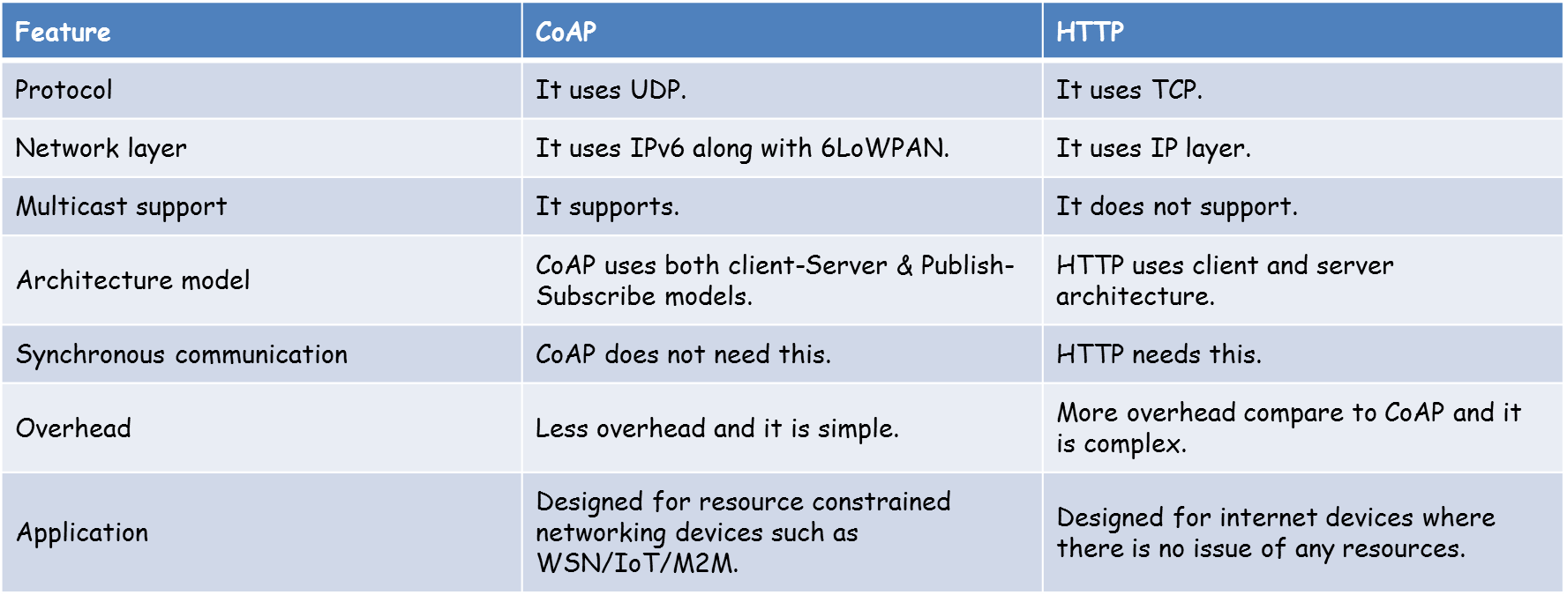
IoT Application Layer Protocols-CoAP
CoAP vs HTTP
* https://www.rfwireless-world.com/Terminology/Difference-between-CoAP-and-HTTP.html

Slide 60
IoT Application Layer Protocols-MQTT
At the end of the 1990s, engineers from IBM and Arcom (acquired in 2006 by Eurotech) were looking for a reliable, lightweight, and cost-effective protocol to monitor and control a large number of sensors and their data from a central server location, as typically used by the oil and gas industries.
Their research resulted in the development and implementation of the Message Queuing Telemetry Transport (MQTT) protocol that is now standardized by the Organization for the Advancement of Structured Information Standards (OASIS).

Slide 61
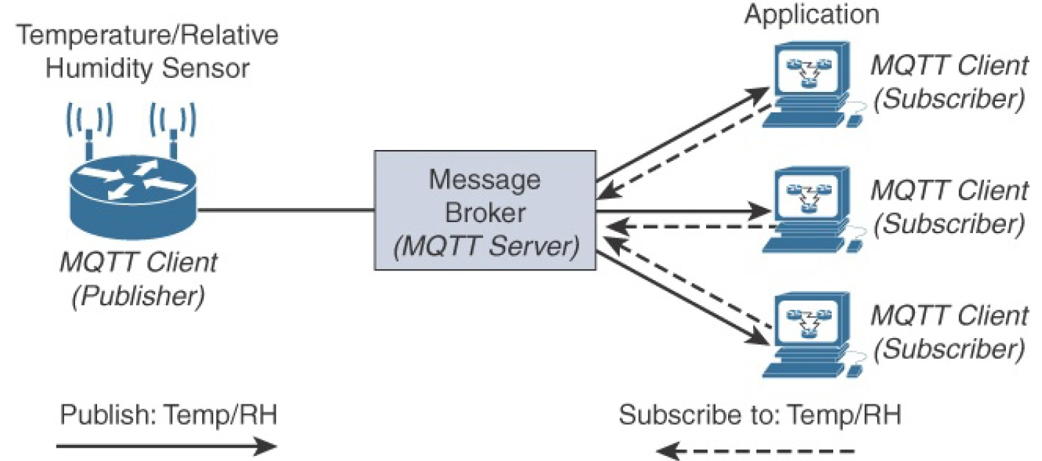
IoT Application Layer Protocols-MQTT
Application Layer Protocols- MQTT
MQTT Publish/Subscribe Framework
Is like Twitter
* IoT Fundamentals: Networking Technologies, Protocols, and Use Cases for the Internet of Thing, Cisco press, 2017
Notes:
An MQTT client can act as a publisher to send data (or resource information) to an MQTT server acting as an MQTT message broker. In Figure, the MQTT client on the left side is a temperature (Temp) and relative humidity (RH) sensor that publishes its Temp/RH data.
The MQTT server (or message broker) accepts the network connection along with application messages, such as Temp/RH data, from the publishers. It also handles the subscription and unsubscription process and pushes the application data to MQTT clients acting as subscribers.
The application on the right side of Figure is an MQTT client that is a subscriber to the Temp/RH data being generated by the publisher or sensor on the left. This model, where subscribers express a desire to receive information from publishers, is well known.
With MQTT, clients can subscribe to all data (using a wildcard character) or specific data from the information tree of a publisher. In addition, the presence of a message broker in MQTT decouples the data transmission between clients acting as publishers and subscribers. In fact, publishers and subscribers do not even know (or need to know) about each other. A benefit of having this decoupling is that the MQTT message broker ensures that information can be buffered and cached in case of network failures. This also means that publishers and subscribers do not have to be online at the same time.
MQTT control packets run over a TCP transport using port 1883. TCP ensures an ordered, lossless stream of bytes between the MQTT client and the MQTT server. Optionally, MQTT can be secured using TLS on port 8883, and WebSocket (defined in RFC 6455) can also be used.

Slide 62
IoT Application Layer Protocols-MQTT
The MQTT protocol defines two types of entities in the network:
a message broker
a number of clients.
The broker is a server that receives all messages from the clients and then routes those messages to relevant destination clients.
A client is anything that can interact with the broker to send and receive messages.
A client could be an IoT sensor in the field or an application in a data center that processes IoT data.
Both publishers and subscribers are called as clients
Getting to know MQTT, online available, developer.ibm.com/articles/iot-mqtt-why-good-for-iot/+&cd=10&hl=en&ct=clnk&gl=ir

Slide 63
IoT Application Layer Protocols-Terminology of MQTT
Client:
Clients can be persistent or transient.
Persistent clients maintain a session with the broker
transient clients are not tracked by the broker.
Clients often connect to the broker through libraries and SDKs.
There are over a dozen libraries available for C, C++, Go, Java, C#, PHP, Python, Node.js, and Arduino.
Get to Know MQTT: The Messaging Protocol for the Internet of Things, online available, https://thenewstack.io/mqtt-protocol-iot/

Slide 64
IoT Application Layer Protocols-Terminology of MQTT
Broker
The broker is the software that receives all the messages from the publishing clients and sends them to the subscribing clients.
It holds the connection to persistent clients.
Since the broker can become the bottleneck or result in a single point of failure, it is often clustered for scalability and reliability.
It is up to the implementers to decide how to create a scalable broker layer.
MQTT brokers include
Commercial: HiveMQ, Xively, AWS IoT, and Loop,
an open source: Mosquitto.
Get to Know MQTT: The Messaging Protocol for the Internet of Things, online available, https://thenewstack.io/mqtt-protocol-iot/

Slide 65
IoT Application Layer Protocols-MQTT
With MQTT, clients can subscribe to all data (using a wildcard character) or specific data from the information tree of a publisher.
In addition, the presence of a message broker in MQTT decouples the data transmission between clients acting as publishers and subscribers.
In fact, publishers and subscribers do not even know (or need to know) about each other.
A benefit of having this decoupling is that the MQTT message broker ensures that information can be buffered and cached in case of network failures.
This also means that publishers and subscribers do not have to be online at the same time.
* IoT Fundamentals: Networking Technologies, Protocols, and Use Cases for the Internet of Thing, Cisco press, 2017

Slide 66
IoT Application Layer Protocols-Terminology of MQTT
Topic
A topic in MQTT is an endpoint to that the clients connect.
It acts as the central distribution hub for publishing and subscribing messages.
A topic is a well-known location for the publisher and subscriber.
Topics are simple, hierarchical strings, encoded in UTF-8, delimited by a forward slash.
For example, building1/room1/temperature and building1/room1/humidity are valid topic names. Subscribers can choose to subscribe to a specific topic or all the subtopics through wildcards.
A subscription to building1/+/temperature will automatically subscribe to the temperature topic of all the rooms in the building.
Similarly, building1/#/ will match all the topics available under building1.
Get to Know MQTT: The Messaging Protocol for the Internet of Things, online available, https://thenewstack.io/mqtt-protocol-iot/
Notes:
The pound sign (#) is a wildcard character that matches any number of levels
within a topic. The multilevel wildcard represents the parent and any number
of child levels. For example, subscribing to adt/lora/adeunis/# enables the
reception of the whole subtree, which could include topic names such as the
following:
adt/lora/adeunis/0018B20000000E9E
adt/lora/adeunis/0018B20000000E8E
adt/lora/adeunis/0018B20000000E9A
The plus sign (+) is a wildcard character that matches only one topic level.
For example, adt/lora/+ allows access to adt/lora/adeunis/ and
adt/lora/abeeway but not to adt/lora/adeunis/0018B20000000E9E.
Topic names beginning with the dollar sign ($) must be excluded by the
server when subscriptions start with wildcard characters (# or +). Often, these
types of topic names are utilized for message broker internal statistics. So
messages cannot be published to these topics by clients. For example, a
subscription to +/monitor/Temp does not receive any messages published to
$SYS/monitor/Temp. This topic could be the control channel for this
temperature sensor.

Slide 67
IoT Application Layer Protocols-Terminology of MQTT
Topic
The pound sign (#) is a wildcard character that matches any number of levels within a topic. The multilevel wildcard represents the parent and any number of child levels.
For example, subscribing to adt/lora/adeunis/# enables the reception of the whole subtree, which could include topic names such as the following:
adt/lora/adeunis/0018B20000000E9E
adt/lora/adeunis/0018B20000000E8E
adt/lora/adeunis/0018B20000000E9A
The plus sign (+) is a wildcard character that matches only one topic level.
For example, adt/lora/+ allows access to adt/lora/adeunis/ and adt/lora/abeeway but not to adt/lora/adeunis/0018B20000000E9E.
Topic names beginning with the dollar sign ($) must be excluded by the server when subscriptions start with wildcard characters (# or +).
Often, these types of topic names are utilized for message broker internal statistics. So messages cannot be published to these topics by clients. For example, a subscription to +/monitor/Temp does not receive any messages published to $SYS/monitor/Temp. This topic could be the control channel for this temperature sensor.
Notes:
The pound sign (#) is a wildcard character that matches any number of levels
within a topic. The multilevel wildcard represents the parent and any number
of child levels. For example, subscribing to adt/lora/adeunis/# enables the
reception of the whole subtree, which could include topic names such as the
following:
adt/lora/adeunis/0018B20000000E9E
adt/lora/adeunis/0018B20000000E8E
adt/lora/adeunis/0018B20000000E9A
The plus sign (+) is a wildcard character that matches only one topic level.
For example, adt/lora/+ allows access to adt/lora/adeunis/ and
adt/lora/abeeway but not to adt/lora/adeunis/0018B20000000E9E.
Topic names beginning with the dollar sign ($) must be excluded by the
server when subscriptions start with wildcard characters (# or +). Often, these
types of topic names are utilized for message broker internal statistics. So
messages cannot be published to these topics by clients. For example, a
subscription to +/monitor/Temp does not receive any messages published to
$SYS/monitor/Temp. This topic could be the control channel for this
temperature sensor.

Slide 68
IoT Application Layer Protocols-MQTT
MQTT is extremely lightweight
it takes up almost no space in a device, so that even small devices with very little computing power can use it.
Each control packet consists of a 2-byte fixed header with optional variable header fields and optional payload.
Note that a control packet can contain a payload up to 256 MB.
Request-response vs. publish-subscribe, part 1: What's the diff? , online available, https://blog.opto22.com/optoblog/request-response-vs-pub-sub-part-1

Slide 69
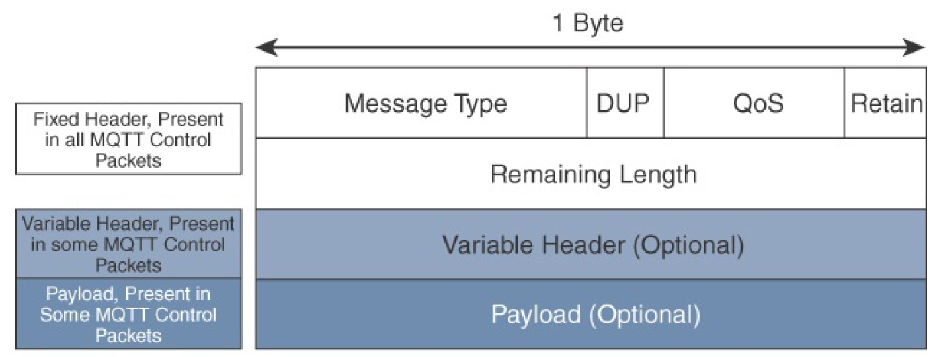
IoT Application Layer Protocols-MQTT
MQTT Message Format
Compared to the CoAP message format, MQTT contains a smaller header of 2 bytes compared to 4 bytes for CoAP
* IoT Fundamentals: Networking Technologies, Protocols, and Use Cases for the Internet of Thing, Cisco press, 2017
Notes:
The next field in the MQTT header is DUP (Duplication Flag). This flag,
when set, allows the client to notate that the packet has been sent previously,
but an acknowledgement was not received.
The QoS header field allows for the selection of three different QoS levels.
These are discussed in more detail later in this chapter.
The next field is the Retain flag. Only found in a PUBLISH message (refer to
Table 6-2), the Retain flag notifies the server to hold onto the message data.
This allows new subscribers to instantly receive the last known value without
having to wait for the next update from the publisher.

Slide 70
IoT Application Layer Protocols-MQTT
Message Type
identifies the kind of MQTT packet within a message
Fourteen different types of control packets are specified in MQTT version 3.1.1.
Each of them has a unique value that is coded into the Message Type field.
* IoT Fundamentals: Networking Technologies, Protocols, and Use Cases for the Internet of Thing, Cisco press, 2017
Notes:
The next field in the MQTT header is DUP (Duplication Flag). This flag,
when set, allows the client to notate that the packet has been sent previously,
but an acknowledgement was not received.
The QoS header field allows for the selection of three different QoS levels.
These are discussed in more detail later in this chapter.
The next field is the Retain flag. Only found in a PUBLISH message (refer to
Table 6-2), the Retain flag notifies the server to hold onto the message data.
This allows new subscribers to instantly receive the last known value without
having to wait for the next update from the publisher.

Slide 71
IoT Application Layer Protocols-MQTT
MQTT Message Types
* IoT Fundamentals: Networking Technologies, Protocols, and Use Cases for the Internet of Thing, Cisco press, 2017

Slide 72
IoT Application Layer Protocols-MQTT
MQTT Message Types
PINGREQ/PINGRESP control packets are used to validate the connections between the client and server.
Similar to ICMP pings that are part of IP, they are a sort of keep alive that helps to maintain and check the TCP session.
* IoT Fundamentals: Networking Technologies, Protocols, and Use Cases for the Internet of Thing, Cisco press, 2017

Slide 73
IoT Application Layer Protocols-MQTT
DUP (Duplication Flag) field:
This flag, when set, allows the client to notate that the packet has been sent previously, but an acknowledgement was not received.
The QoS header field:
allows for the selection of three different QoS levels.
Retain flag field:
Only found in a PUBLISH message, the Retain flag notifies the server to hold onto the message data.
This allows new subscribers to instantly receive the last known value without having to wait for the next update from the publisher.
* IoT Fundamentals: Networking Technologies, Protocols, and Use Cases for the Internet of Thing, Cisco press, 2017

Slide 74
IoT Application Layer Protocols-MQTT
Remaining Length:
Specifies the number of bytes in the MQTT packet following this field.
* IoT Fundamentals: Networking Technologies, Protocols, and Use Cases for the Internet of Thing, Cisco press, 2017
Notes:
The next field in the MQTT header is DUP (Duplication Flag). This flag,
when set, allows the client to notate that the packet has been sent previously,
but an acknowledgement was not received.
The QoS header field allows for the selection of three different QoS levels.
These are discussed in more detail later in this chapter.
The next field is the Retain flag. Only found in a PUBLISH message (refer to
Table 6-2), the Retain flag notifies the server to hold onto the message data.
This allows new subscribers to instantly receive the last known value without
having to wait for the next update from the publisher.

Slide 75
IoT Application Layer Protocols-MQTT
QoS 0:
This is a best-effort and unacknowledged data service referred to as “at most once” delivery.
The publisher sends its message one time to a server, which transmits it once to the subscribers.
No response is sent by the receiver, and no retry is performed by the sender.
The message arrives at the receiver either once or not at all.
QoS 1:
This QoS level ensures that the message delivery between the publisher and server and then between the server and subscribers occurs at least once.
In PUBLISH and PUBACK packets, a packet identifier is included in the variable header.
If the message is not acknowledged by a PUBACK packet, it is sent again.
This level guarantees “at least once” delivery.
* IoT Fundamentals: Networking Technologies, Protocols, and Use Cases for the Internet of Thing, Cisco press, 2017
Notes:
These are the three levels of MQTT QoS:
QoS 0: This is a best-effort and unacknowledged data service referred
to as “at most once” delivery. The publisher sends its message one time
to a server, which transmits it once to the subscribers. No response is
sent by the receiver, and no retry is performed by the sender. The
message arrives at the receiver either once or not at all.
QoS 1: This QoS level ensures that the message delivery between the
publisher and server and then between the server and subscribers occurs
at least once. In PUBLISH and PUBACK packets, a packet identifier is
included in the variable header. If the message is not acknowledged by a
PUBACK packet, it is sent again. This level guarantees “at least once”
delivery.
QoS 2: This is the highest QoS level, used when neither loss nor
duplication of messages is acceptable. There is an increased overhead
associated with this QoS level because each packet contains an optional
variable header with a packet identifier. Confirming the receipt of a
PUBLISH message requires a two-step acknowledgement process. The
first step is done through the PUBLISH/PUBREC packet pair, and the
second is achieved with the PUBREL/PUBCOMP packet pair. This
level provides a “guaranteed service” known as “exactly once” delivery,
with no consideration for the number of retries as long as the message is
delivered once.

Slide 76
IoT Application Layer Protocols-MQTT
QoS 2:
This is the highest QoS level, used when neither loss nor duplication of messages is acceptable.
There is an increased overhead associated with this QoS level because each packet contains an optional variable header with a packet identifier.
Confirming the receipt of a PUBLISH message requires a two-step acknowledgement process.
The first step is done through the PUBLISH/PUBREC packet pair, and the second is achieved with the PUBREL/PUBCOMP packet pair.
This level provides a “guaranteed service” known as “exactly once” delivery, with no consideration for the number of retries as long as the message is delivered once.
* IoT Fundamentals: Networking Technologies, Protocols, and Use Cases for the Internet of Thing, Cisco press, 2017
Notes:
These are the three levels of MQTT QoS:
QoS 0: This is a best-effort and unacknowledged data service referred
to as “at most once” delivery. The publisher sends its message one time
to a server, which transmits it once to the subscribers. No response is
sent by the receiver, and no retry is performed by the sender. The
message arrives at the receiver either once or not at all.
QoS 1: This QoS level ensures that the message delivery between the
publisher and server and then between the server and subscribers occurs
at least once. In PUBLISH and PUBACK packets, a packet identifier is
included in the variable header. If the message is not acknowledged by a
PUBACK packet, it is sent again. This level guarantees “at least once”
delivery.
QoS 2: This is the highest QoS level, used when neither loss nor
duplication of messages is acceptable. There is an increased overhead
associated with this QoS level because each packet contains an optional
variable header with a packet identifier. Confirming the receipt of a
PUBLISH message requires a two-step acknowledgement process. The
first step is done through the PUBLISH/PUBREC packet pair, and the
second is achieved with the PUBREL/PUBCOMP packet pair. This
level provides a “guaranteed service” known as “exactly once” delivery,
with no consideration for the number of retries as long as the message is
delivered once.

Slide 77
IoT Application Layer Protocols-MQTT
The QoS process is symmetric in regard to the roles of sender and receiver, but two separate transactions exist.
One transaction occurs between the publishing client and the MQTT server,
and the other transaction happens between the MQTT server and the subscribing client.
The publishing client side sets the QoS level for communications to the MQTT server.
On the other side, the client subscriber sets the QoS level through the subscription with the MQTT server.
In most cases, QoS remains the same between clients and broker end to end.
However, you should be aware that in some scenarios, QoS levels change and are not the same end to end.
* IoT Fundamentals: Networking Technologies, Protocols, and Use Cases for the Internet of Thing, Cisco press, 2017
Notes:
These are the three levels of MQTT QoS:
QoS 0: This is a best-effort and unacknowledged data service referred
to as “at most once” delivery. The publisher sends its message one time
to a server, which transmits it once to the subscribers. No response is
sent by the receiver, and no retry is performed by the sender. The
message arrives at the receiver either once or not at all.
QoS 1: This QoS level ensures that the message delivery between the
publisher and server and then between the server and subscribers occurs
at least once. In PUBLISH and PUBACK packets, a packet identifier is
included in the variable header. If the message is not acknowledged by a
PUBACK packet, it is sent again. This level guarantees “at least once”
delivery.
QoS 2: This is the highest QoS level, used when neither loss nor
duplication of messages is acceptable. There is an increased overhead
associated with this QoS level because each packet contains an optional
variable header with a packet identifier. Confirming the receipt of a
PUBLISH message requires a two-step acknowledgement process. The
first step is done through the PUBLISH/PUBREC packet pair, and the
second is achieved with the PUBREL/PUBCOMP packet pair. This
level provides a “guaranteed service” known as “exactly once” delivery,
with no consideration for the number of retries as long as the message is
delivered once.

Slide 78
IoT Application Layer Protocols-MQTT
MQTT QoS Flows
* IoT Fundamentals: Networking Technologies, Protocols, and Use Cases for the Internet of Thing, Cisco press, 2017
Notes:
The client on each side of the MQTT flow sets the QoS level.
The publishing client side sets the QoS level for communications
to the MQTT server. On the other side, the client subscriber sets
the QoS level through the subscription with the MQTT server. As
illustrated in Figure 6-13, in most cases, QoS remains the same
between clients and broker end to end. However, you should be
aware that in some scenarios, QoS levels change and are not the
same end to end.

Slide 79
IoT Application Layer Protocols-MQTT
MQTT sessions between each client and server consist of four phases:
session establishment,
authentication,
data exchange, and
session termination.
Each client connecting to a server has a unique client ID, which allows the identification of the MQTT session between both parties.
When the server is delivering an application message to more than one client, each client is treated independently.
* IoT Fundamentals: Networking Technologies, Protocols, and Use Cases for the Internet of Thing, Cisco press, 2017
Notes:
The next field in the MQTT header is DUP (Duplication Flag). This flag,
when set, allows the client to notate that the packet has been sent previously,
but an acknowledgement was not received.
The QoS header field allows for the selection of three different QoS levels.
These are discussed in more detail later in this chapter.
The next field is the Retain flag. Only found in a PUBLISH message (refer to
Table 6-2), the Retain flag notifies the server to hold onto the message data.
This allows new subscribers to instantly receive the last known value without
having to wait for the next update from the publisher.

Slide 80
IoT Application Layer Protocols- MQTT Security
Securing MQTT connections through TLS is considered optional because it calls for more resources on constrained nodes.
When TLS is not used, the client sends a clear-text username and password during the connection initiation.
MQTT server implementations may also accept anonymous client connections (with the username/password being “blank”).
When TLS is implemented, a client must validate the server certificate for proper authentication.
Client authentication can also be performed through certificate exchanges with the server, depending on the server configuration.
Notes:
The pound sign (#) is a wildcard character that matches any number of levels
within a topic. The multilevel wildcard represents the parent and any number
of child levels. For example, subscribing to adt/lora/adeunis/# enables the
reception of the whole subtree, which could include topic names such as the
following:
adt/lora/adeunis/0018B20000000E9E
adt/lora/adeunis/0018B20000000E8E
adt/lora/adeunis/0018B20000000E9A
The plus sign (+) is a wildcard character that matches only one topic level.
For example, adt/lora/+ allows access to adt/lora/adeunis/ and
adt/lora/abeeway but not to adt/lora/adeunis/0018B20000000E9E.
Topic names beginning with the dollar sign ($) must be excluded by the
server when subscriptions start with wildcard characters (# or +). Often, these
types of topic names are utilized for message broker internal statistics. So
messages cannot be published to these topics by clients. For example, a
subscription to +/monitor/Temp does not receive any messages published to
$SYS/monitor/Temp. This topic could be the control channel for this
temperature sensor.

Slide 81
IoT Application Layer Protocols
MQTT vs HTTP
MQTT is data centric whereas HTTP is document-centric.
HTTP is request-response protocol for client-server computing and not always optimized for mobile devices. Whereas MQTT is lightweight protocol (MQTT transfers data as a byte array) and publish/subscribe model, which makes it perfect for resource-constrained devices and help to save battery.
MQTT has pretty short specification. There are only CONNECT, PUBLISH, SUBSCRIBE, UNSUBSCRIBE and DISCONNECT types that are significant for developers. Whereas HTTP specifications are much longer.
MQTT has a very short message header and the smallest packet message size of 2 bytes
* https://medium.com/mqtt-buddy/mqtt-vs-http-which-one-is-the-best-for-iot-c868169b3105
Notes:
MQTT is data centric whereas HTTP is document-centric. HTTP is request-response protocol for client-server computing and not always optimized for mobile devices. Main solid benefits of MQTT in these terms are lightweightness (MQTT transfers data as a byte array) and publish/subscribe model, which makes it perfect for resource-constrained devices and help to save battery.
Besides, publish/subscribe model provides clients with independent existence from one another and enhance the reliability of the whole system. When one client is out of order the whole system can keep on working properly.
Speed and Delivery
According to measurements in 3G networks, throughput of MQTT is 93 times faster than HTTP’s.
Besides, in comparison to HTTP, MQTT Protocol ensures high delivery guarantees. There are 3 levels of Quality of Services:
- at most once: guarantees a best effort delivery.
- at least once: guaranteed that a message will be delivered at least once. But the message can also be delivered more than once.
- exactly once: guarantees that each message is received only once by the counterpart
MQTT also provides users with options of Last will & Testament and Retained messages. The first means that in case of unexpected disconnection of a client all subscribed clients will get a message from a broker. Retained message means that a newly subscribed client will get an immediate status update.
HTTP Protocol has none of these abilities.
Complexity and Message Size MQTT has pretty short specification. There are only CONNECT, PUBLISH, SUBSCRIBE, UNSUBSCRIBE and DISCONNECT types that are significant for developers. Whereas HTTP specifications are much longer.
MQTT has a very short message header and the smallest packet message size of 2 bytes. Using text message format by HTTP protocol allows it to compose lengthy headers and messages. It helps to eliminate troubles because it can be read by humans, but at the same time it’s needless for resource-constrained devices.

Slide 82
IoT Application Layer Protocols
MQTT vs HTTP
According to measurements in 3G networks, throughput of MQTT is 93 times faster than HTTP’s.
Besides, in comparison to HTTP, MQTT Protocol ensures high delivery guarantees. There are 3 levels of Quality of Services:
at most once: guarantees a best effort delivery.
at least once: guaranteed that a message will be delivered at least once. But the message can also be delivered more than once.
exactly once: guarantees that each message is received only once by the counterpart
* https://medium.com/mqtt-buddy/mqtt-vs-http-which-one-is-the-best-for-iot-c868169b3105

Slide 83
IoT Application Layer Protocols
MQTT vs HTTP
Features | MQTT | HTTP
Full form | Message Queue Telemetry Transport | Hyper Text Transfer Protocol
Architecture | It has publish/subscribe architecture. Here devices can publish any topics and can also subscribe for any topics for any updates. | It has request/response means Client/Server architecture.
Upper layer protocol | It runs over TCP. | It runs over TCP and UDP.
message size | small, . | Large,
Message format | binary with 2Byte header | ASCII format.
Data distribution | 1 to 0/1/N | one to one only , more POST
Data security | Yes, It uses SSL/TLS for security | NO, hence HTTPS is used to provide data security
Complexity | Simple | Client more complex (ASCII parser)
Encryption | It encrypts payload i.e. it is payload agnostic | data are not encrypted before transmission
When to use | if your project is to let the fridge to communicate with the thermometer to adapt the engine pump, you can use the MQTT easily | if you need to collect big data from around the world, then you can think to use HTTP
* https://iotdunia.com/mqtt-and-http/

Slide 84
IoT Application Layer Protocols
CoAP vs MQTT
Factor | CoAP | MQTT
Main transport protocol | UDP | TCP
Typical messaging | Request/response | Publish/Subscribe
Effectiveness in LLNs | Excellent | low
Security | DTLS | SSl/TLS
Communication model | one-to-one | Many-to-many
Strengths | Lightweight, fast, low overhead, support for multicasting messages | Robust communication, simple management, scalability
Weakness | Not as reliable as MQTT | Higher overhead, no multicasting support
* IoT Fundamentals: Networking Technologies, Protocols, and Use Cases for the Internet of Thing, Cisco press, 2017

